Slide 1

Movie Recommendation System In Website -By Raunak(2101331520107) ,Sourabh (2101331520127) ,Anush(2101331520024)

Slide 2

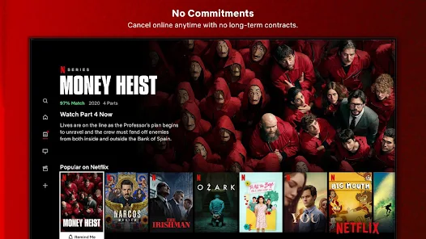
Introduction
In this hustling world, entertainment is a necessity for each one of us to refresh our mood and energy. Entertainment regains our confidence for work, and we can work more enthusiastically. For revitalizing ourselves, we can listen to our preferred music or can watch movies of our choice. For watching favorable movies online we can utilize movie recommendation systems, which are more reliable, since searching of preferred movies will require more and more time which one cannot afford to waste.
Python is a popular programming language for building such recommendation systems due to its simplicity, flexibility, and extensive libraries. In this presentation, we will explore how to build a movie recommendation system using Python.

Slide 3
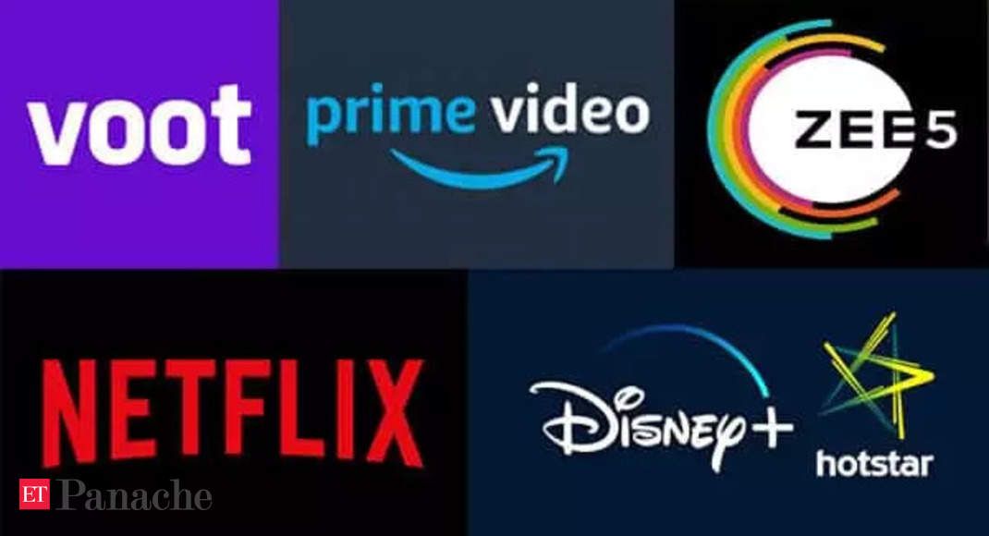
TYPES OF MOVIE RECOMMENDATION SYSTEM
Movie recommendation system is of three types:-
Content-Based Filtering
Collaborative filtering
Hybrid methods

Slide 4
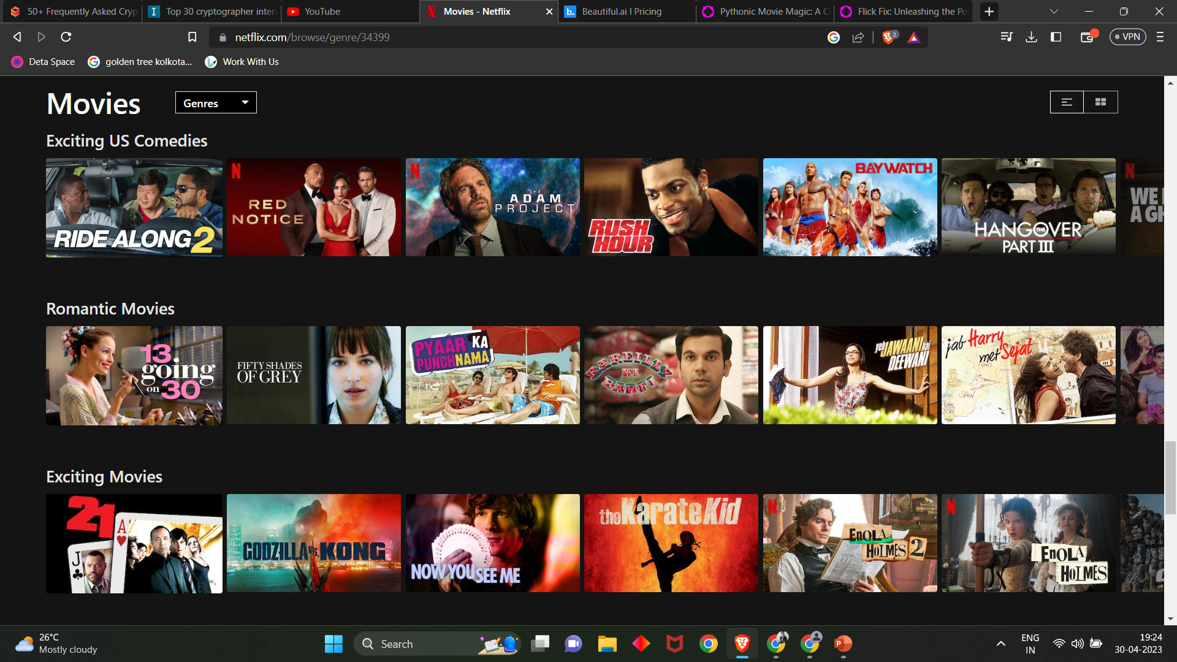
Content-Based Filtering
Content-based filtering is another popular method used in movie recommendation systems. This method looks at the characteristics of individual movies to make recommendations. The system analyzes data about the genre, actors, directors, and other features of a movie to determine what other movies are similar.
Once the system has identified these similarities, it can then recommend movies to users based on their preferences. This method is effective because it takes into account the specific qualities of a movie that a user enjoys, rather than relying solely on the opinions of others.
Netflix.in

Slide 5
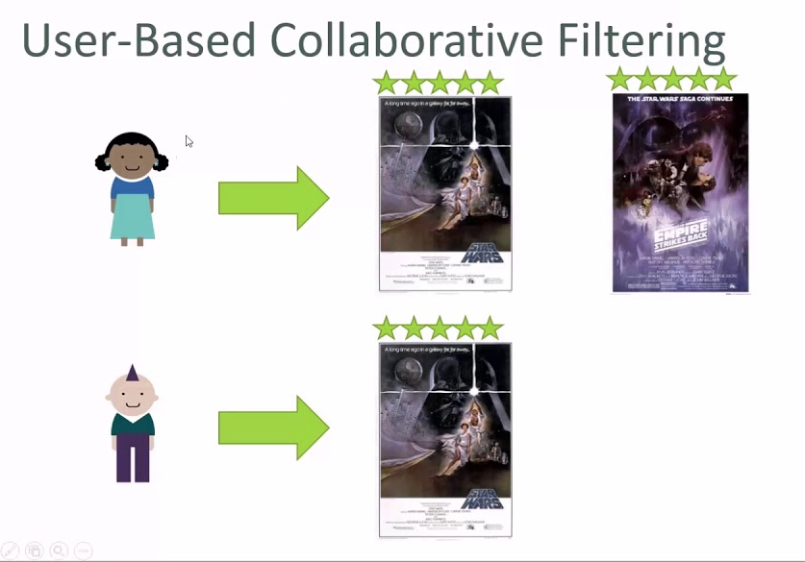
Collaborative Filtering
Collaborative filtering is one of the most popular methods used in movie recommendation systems. This method relies on the idea that people who have similar tastes in movies will also enjoy similar movies. The system collects data about the movies that each user has watched and analyzes this data to find patterns and similarities between users.
Once the system has identified these patterns, it can then recommend movies to users based on what other users with similar tastes have enjoyed. This method is effective because it takes into account the opinions and preferences of a large group of people, rather than just one individual.

Slide 6
Hybrid Methods
Many movie recommendation systems use a combination of both collaborative filtering and content-based filtering. These hybrid methods are often more effective than either method alone because they take into account both the opinions of a large group of people and the specific qualities of individual movies.
By combining these two methods, a recommendation system can provide more accurate and personalized recommendations to users. This is important because it helps users to discover new movies that they may not have otherwise found on their own.

Slide 7





Software and Libraries that are used:-
JUPYTER AND PYCHARM AS python IDE
PANDAS
NUMPY
SCKIT-LEARN
STREAMLIT
AND MANY MORE LIKE AST AND PICKLE,ETC

Slide 8

STEPS OF THE PROJECT
DATA COLLECTION AND CLEANING
CHOOSING A MODEL
TRAINING A MODEL
DEPLOYING MODEL IN WEBSITE

Slide 9
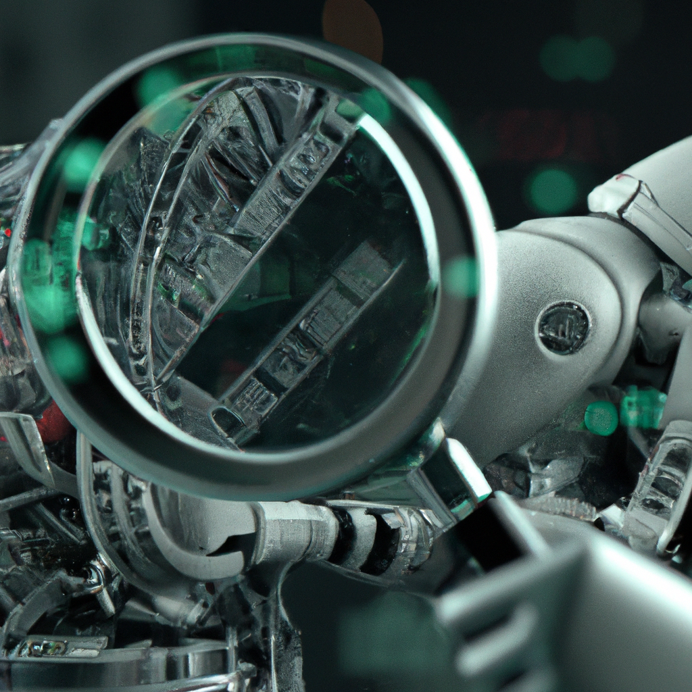
Data Collection and Cleaning
The first step in building a movie recommendation system is to gather data about movies and users' ratings. This data can be obtained from public databases such as IMDb or through web scraping but we have collected it from Kaggle in which there are 5000 movies and data is took from TMDB(The Movie Database).
Once the data is collected, it needs to be cleaned and preprocessed. This includes removing duplicates, handling missing values, and converting categorical data into numerical data. Python provides several libraries such as Pandas and NumPy that make this process easier.

Slide 10
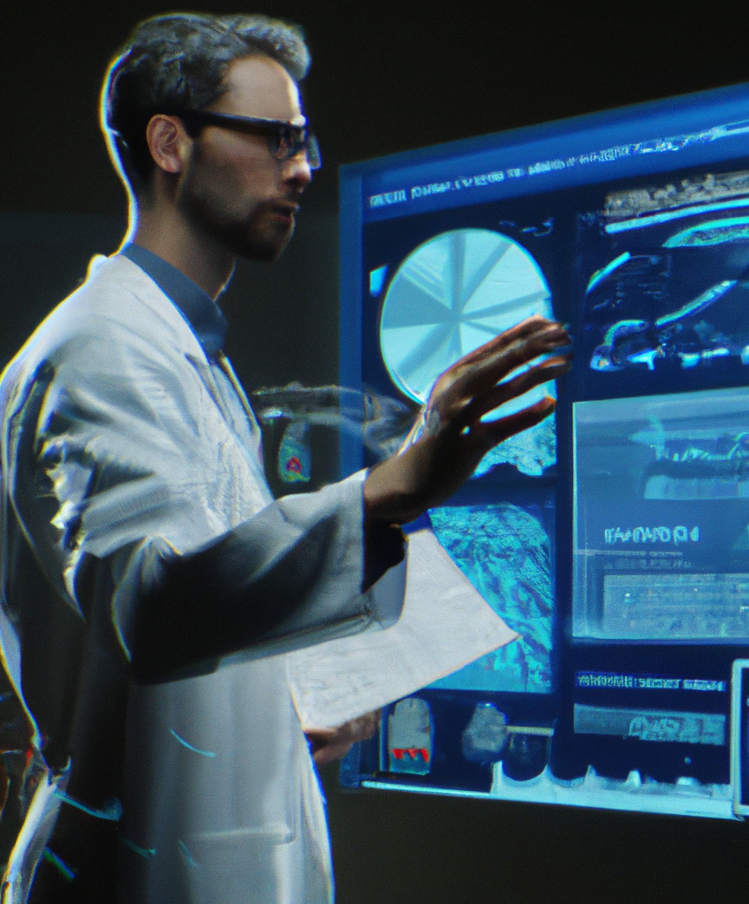
Choosing A Model
Before deciding a model, it's important to understand the data and identify patterns. Choosing A model helps in deciding pattern and workflow of the data and how you can link and compare two data and try to find similarity between them.
So there are many different models like Clustering Algorithm or Matrix Factorization which is used for Collaborative Filtering and for Content based there are similarity metrices like cosine similarity, Euclidian Distance and Dot product to find similarity between two vectors. So I chose two model:-
User-based Collaborative Filtering
Content based using Cosine Similarity
But after checking accuracy of both model in given dataset I used Cosine Similarity which is easy to use and is best suited when you have high dimensional features, especially in information retrieval and text mining and have small data.

Slide 11
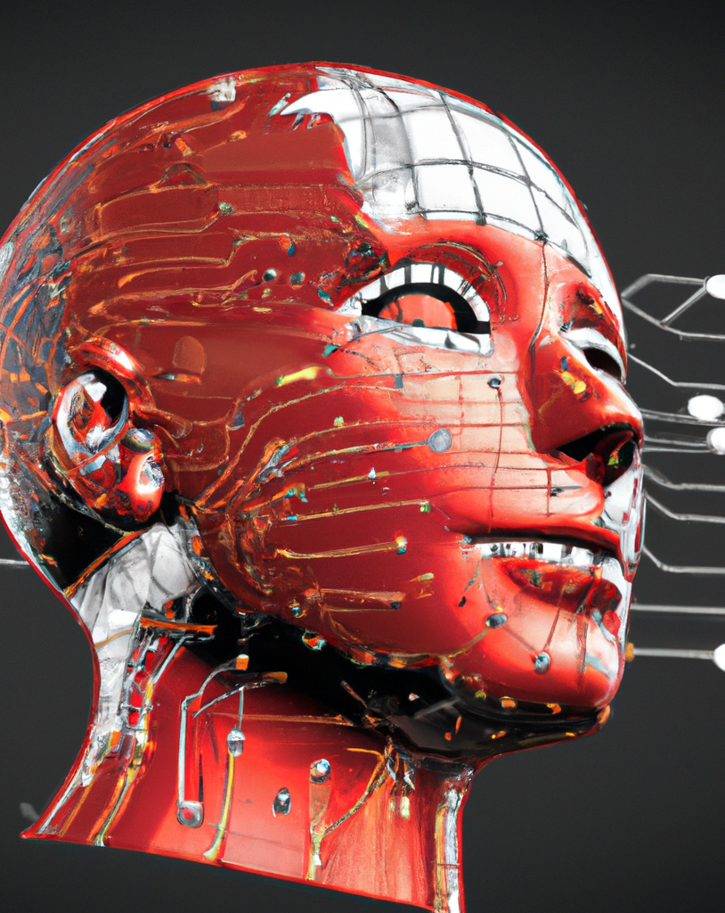
Preparing A Model
Next Procedure is to prepare a model .In this procedure we need to first convert all data in Vector Form by using Count Vectorizer in Scikit-Learn library and then we will be using our model cosine similarity which is also present in Scikit-Learn Library. Then we will sort it and put all things in a list and then will extract top 5 and will print it.

Slide 12
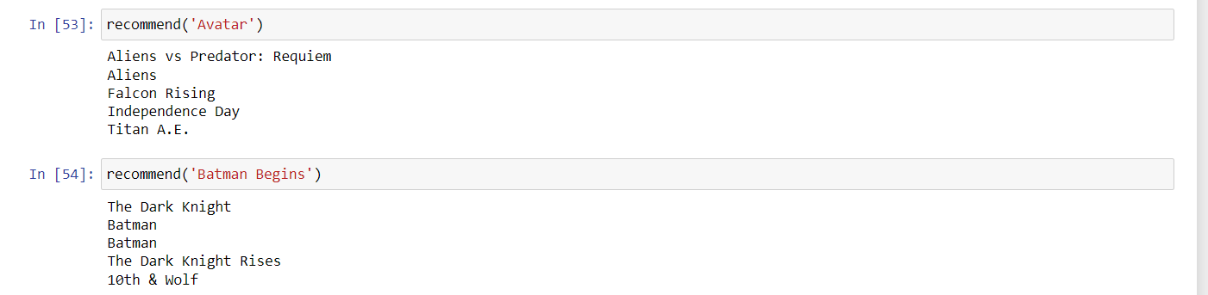
RESULT

Slide 13
DEPLOYING ML MODEL IN WEBSITE
Once you have your machine learning model saved to disk, you can create a Streamlit app that loads the model and allows users to interact with it.
Streamlit is a Python library that allows you to create interactive web applications using a simple syntax.
You can use Streamlit to create a web interface that allows users to input data and receive predictions from your machine learning model.
Take help of streamlit documentation for adding columns and all buttons.
This model will be deployed in local host firstly , if you want to host on server you can use Heroku or AWS or any other dedicated server.

Slide 14
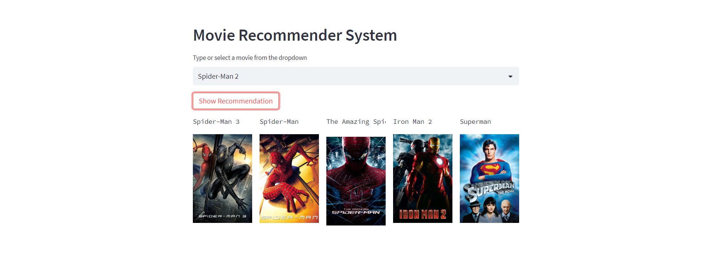
USER-INTERFACE

Slide 15

CONCLUSION
Overall, movie recommendation systems are an essential tool in helping viewers discover new movies that they will enjoy. Whether using collaborative filtering, content-based filtering, or a hybrid approach, these systems provide a personalized and convenient way for users to find new movies to watch.
While there are some challenges and limitations, the benefits of movie recommendation systems far outweigh any drawbacks. As technology continues to improve, we can expect to see even more advanced and accurate recommendation systems in the future.

Slide 16
THANK YOU

